Slide 1



COVID-19 IS A CLOUD SECURITY CATALYST
@RaduVunvulea

Slide 2

GLOBAL ADOPTION OF DIGITIZATION HAS INCREASED TO 55% IN THE LAST SEVEN YEARS
https://www.mckinsey.com/business-functions/strategy-and-corporate-finance/our-insights/how-covid-19-has-pushed-companies-over-the-technology-tipping-point-and-transformed-business-forever

Slide 3


48% HAD TO ACCELERATE CLOUD MIGRATION DURING THE PANDEMIC
https://www.centrify.com/

Slide 4

60% ADJUSTED CLOUD CYBERSECURITY POSTURES AS A RESULT OF DISTRIBUTED WORKFORCES
https://www.centrify.com/

Slide 5
60% ADJUSTED CLOUD CYBERSECURITY POSTURES AS A RESULT OF DISTRIBUTED WORKFORCES
TOP PRIORITIES FOR THE NEXT YEAR:
38% SECURING REMOTE WORKFORCE
36% USING CLOUD NATIVE SERVICES
https://www.centrify.com/

Slide 6
COVID-19 SECURITY
IMPACT
https://www2.deloitte.com/ch/en/pages/risk/articles/impact-covid-cybersecurity.html

Slide 7

250% increase of
cyber-attacks in EU
COVID-19 SECURITY
IMPACT
https://www2.deloitte.com/ch/en/pages/risk/articles/impact-covid-cybersecurity.html

Slide 8

273% increase of large-scale breaches in 2020
https://www2.deloitte.com/ch/en/pages/risk/articles/impact-covid-cybersecurity.html

Slide 9

47% of individuals fall for phishing scams while working at home
COVID-19 SECURITY
IMPACT
https://www2.deloitte.com/ch/en/pages/risk/articles/impact-covid-cybersecurity.html

Slide 10


Phishing attacks increased by 350%
COVID-19 SECURITY
IMPACT
https://www2.deloitte.com/ch/en/pages/risk/articles/impact-covid-cybersecurity.html

Slide 11

February to May 2020 more than 500.000 people globally were affected by breaches
where personal data of video conferencing users was stolen and sold on the dark web.
COVID-19 SECURITY
IMPACT
https://www2.deloitte.com/ch/en/pages/risk/articles/impact-covid-cybersecurity.html

Slide 12
WHAT ABOUT CLOUD?
https://www2.deloitte.com/ch/en/pages/risk/articles/impact-covid-cybersecurity.html

Slide 13
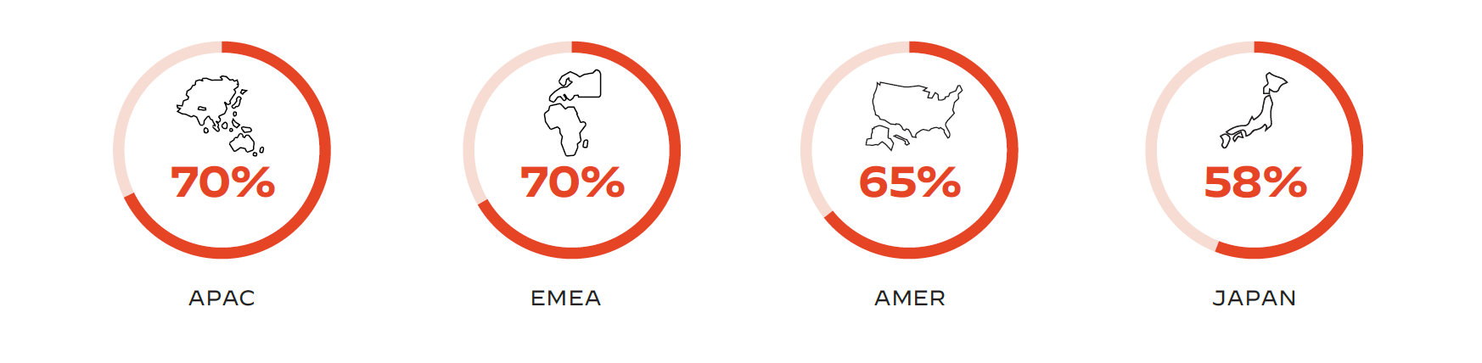
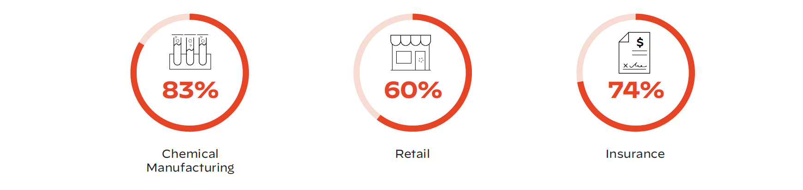
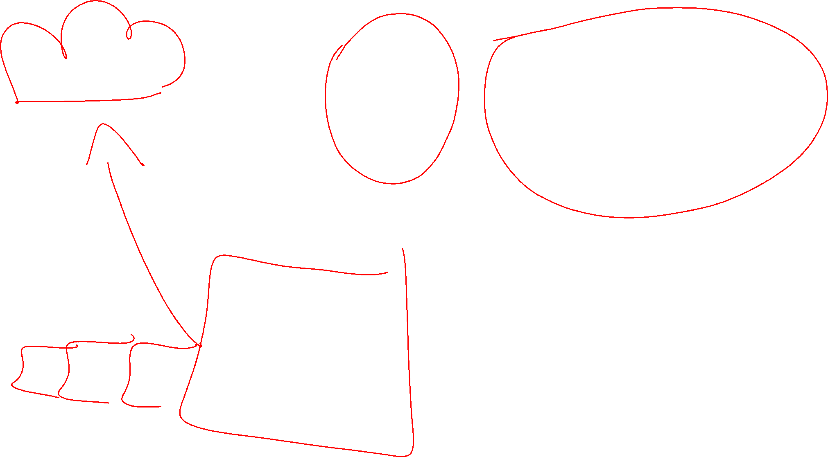
Increases in cloud workloads per region
Increases in cloud workloads by industry
https://www.paloaltonetworks.com/resources/infographics/unit42-covid-19-amplifies-cloud-security-challenges

Slide 14

VEEAM | 200GB | CUSTOMER DATA | AWS S3
AWS EC2 | PUBLIC IP | UNSECURE DATABASE
https://www.venafi.com/blog/7-data-breaches-caused-human-error-did-encryption-play-role
Notes:
Veeam—Customer records compromised by unprotected database Near the end of August 2018, the Shodan search engine indexed an Amazon-hosted IP. Bob Diachenko, director of cyber risk research at Hacken.io, came across the IP on 5 September and quickly determined that the IP resolved to a database left unprotected by the lack of a password. The exposed database contained 200 gigabytes worth of data belonging to Veeam, a backup and data recovery company. Among that data were customer records including names, email addresses and some IP addresses.
How encryption may become a factor in scenarios like this: User names and passwords are a relatively weak way of securing private access. Plus, if an organization does not maintain complete control of the private keys that govern access for internal systems, attackers have a better chance of gaining access.
Impact: Within three hours of learning about the exposure, Veeam took the server offline. The company also reassured TechCrunch that it would “conduct a deeper investigation and… take appropriate actions based on our findings.”

Slide 15





Pipeline Production
Pipeline Testing
Pipeline Dev
CI/CD Machine(s)
Application Repo
Storage
Account Key
Infrastructure Repo
Dev Hero
Pipelines Repo
Repository
(e.g. GitHub

Slide 16

CLOUD ENV PROTECTION
DDOS
WAF
THREAD DETECTION
DATA PROTECTION PRODUCT
DATA DISCOVERY
DATA DESENSITIZATION
DLP
OPERATION AUDIT
LOG MANAGEMENT
ACCESS CONTROL
AUTHORIZATION
AUTHENTIFICATION
CLOUD PRODUCT PROTECTION
DATA ENCRYPTION
DATA RECOVERY
DATA INTEGRITY
Cloud PLATFORM PROTECTION
PHYSICAL SECURITY
HW Security
VRTLZTN
SECURITY

Slide 17

WHAT CAN WE DO?

Slide 18


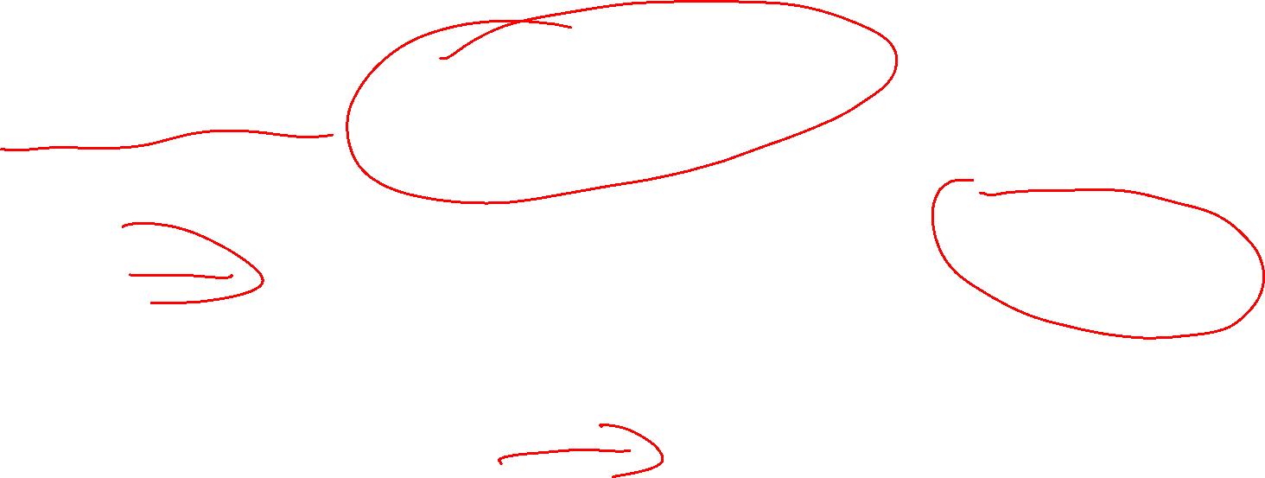
WHAT CAN WE DO?
Limit the use the cloud preview services and features
Private preview
NO SLA
NO FORMAL SUPPORT
Public preview
NO SLA
General Availability
SLA
FORMAL SUPPORT

Slide 19
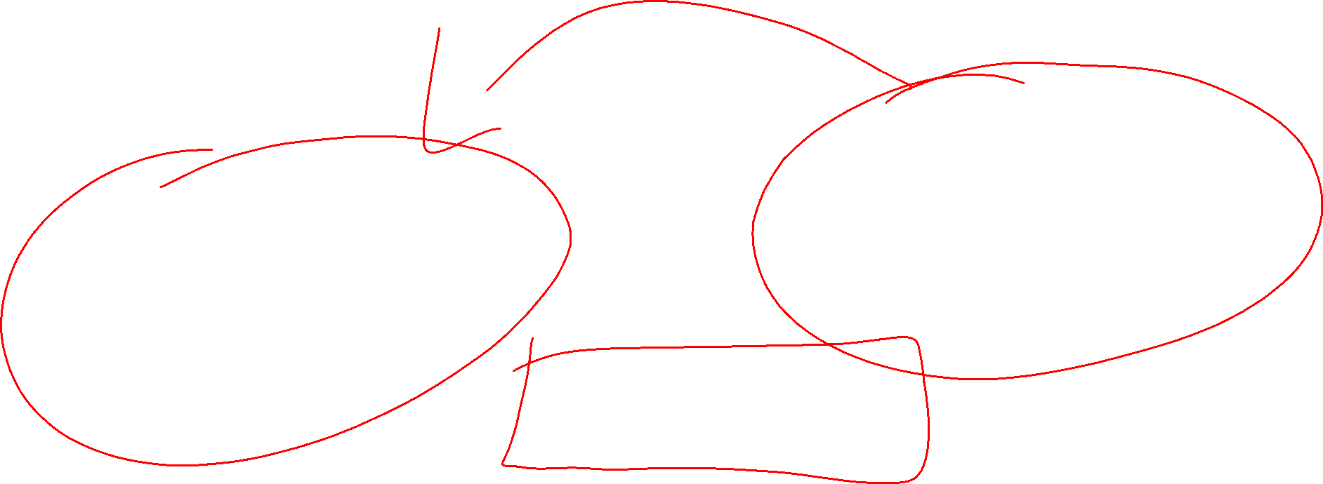
WHAT CAN WE DO?
Limit the use the cloud preview services and features
Private preview
NO SLA
NO FORMAL SUPPORT
PRODUCTION &
PERSONAL / SENSITIVE
DATA ENV
Public preview
General Availability
SLA
FORMAL SUPPORT

Slide 20
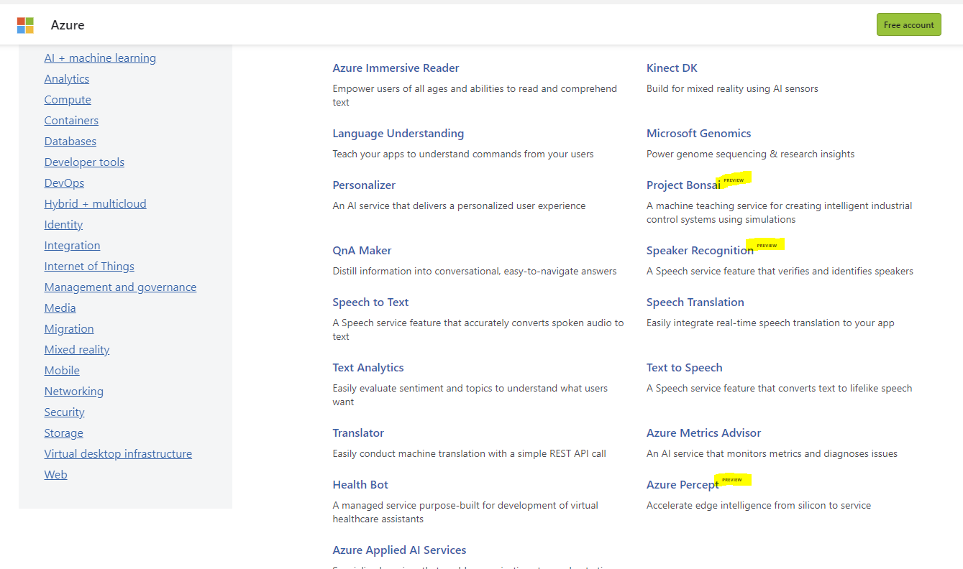
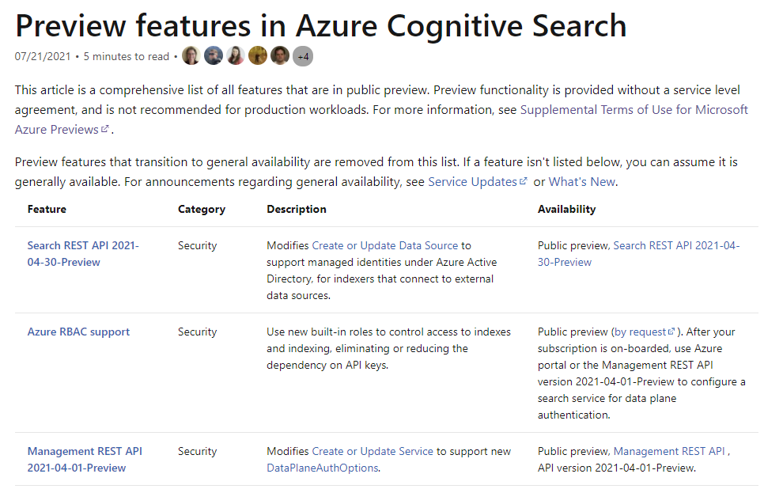

https://azure.microsoft.com/en-us/service
https://docs.microsoft.com/en-us/azure/search/search-api-preview

Slide 21


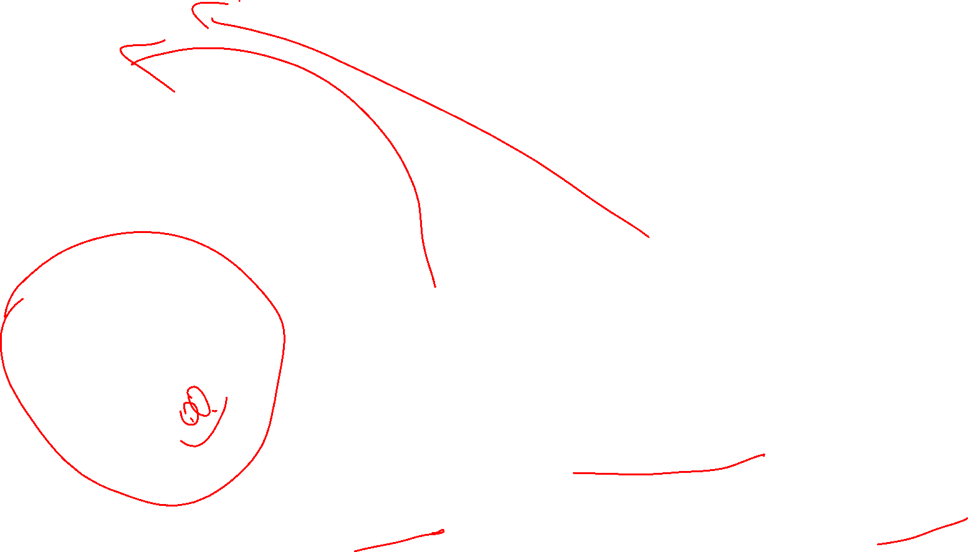
WHAT CAN WE DO?
MORE:
Education
LESS:
Neglect and ignore
IT
FINANCIAL
HR
…

Slide 22
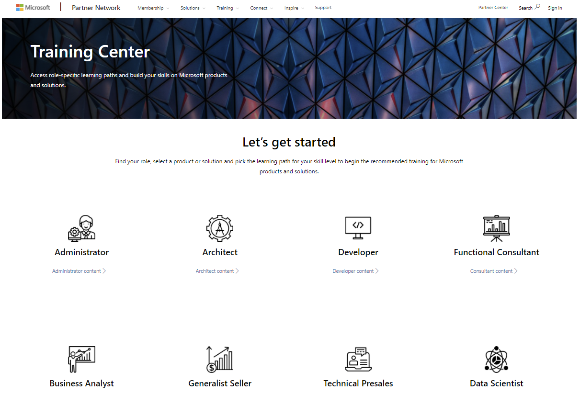
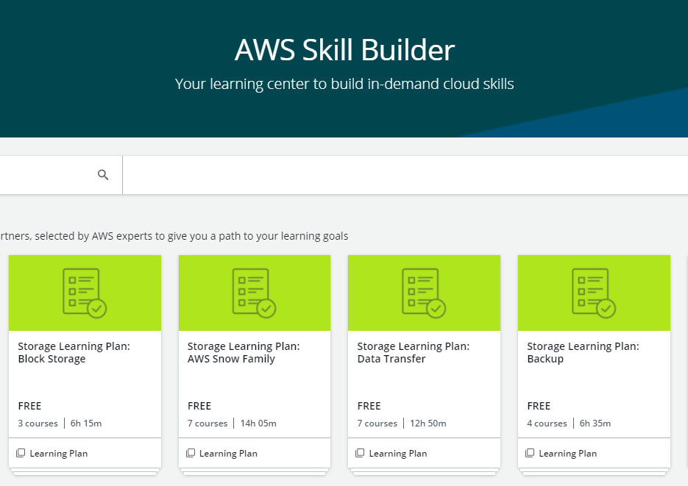
https://partner.microsoft.com/en-us/training/training-center
https://explore.skillbuilder.aws/learn/signin

Slide 23

WHAT CAN WE DO?
MORE:
Identity and Access Management
LESS:
’Master users’
‘Account master keys/tokens’

Slide 24



IAM POLICIES
AWS SIGNATURE
AZURE AD RBAC
AZURE SAS
LIMIT ANONYMOUS PUBLIC READ ACCESS
ENABLE FIREWALL RULES

Slide 25



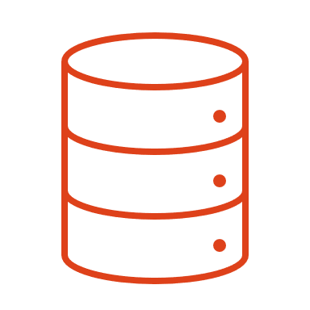

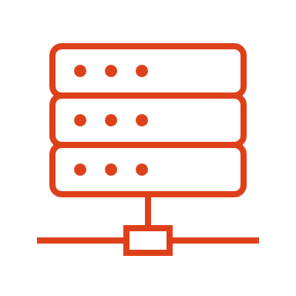


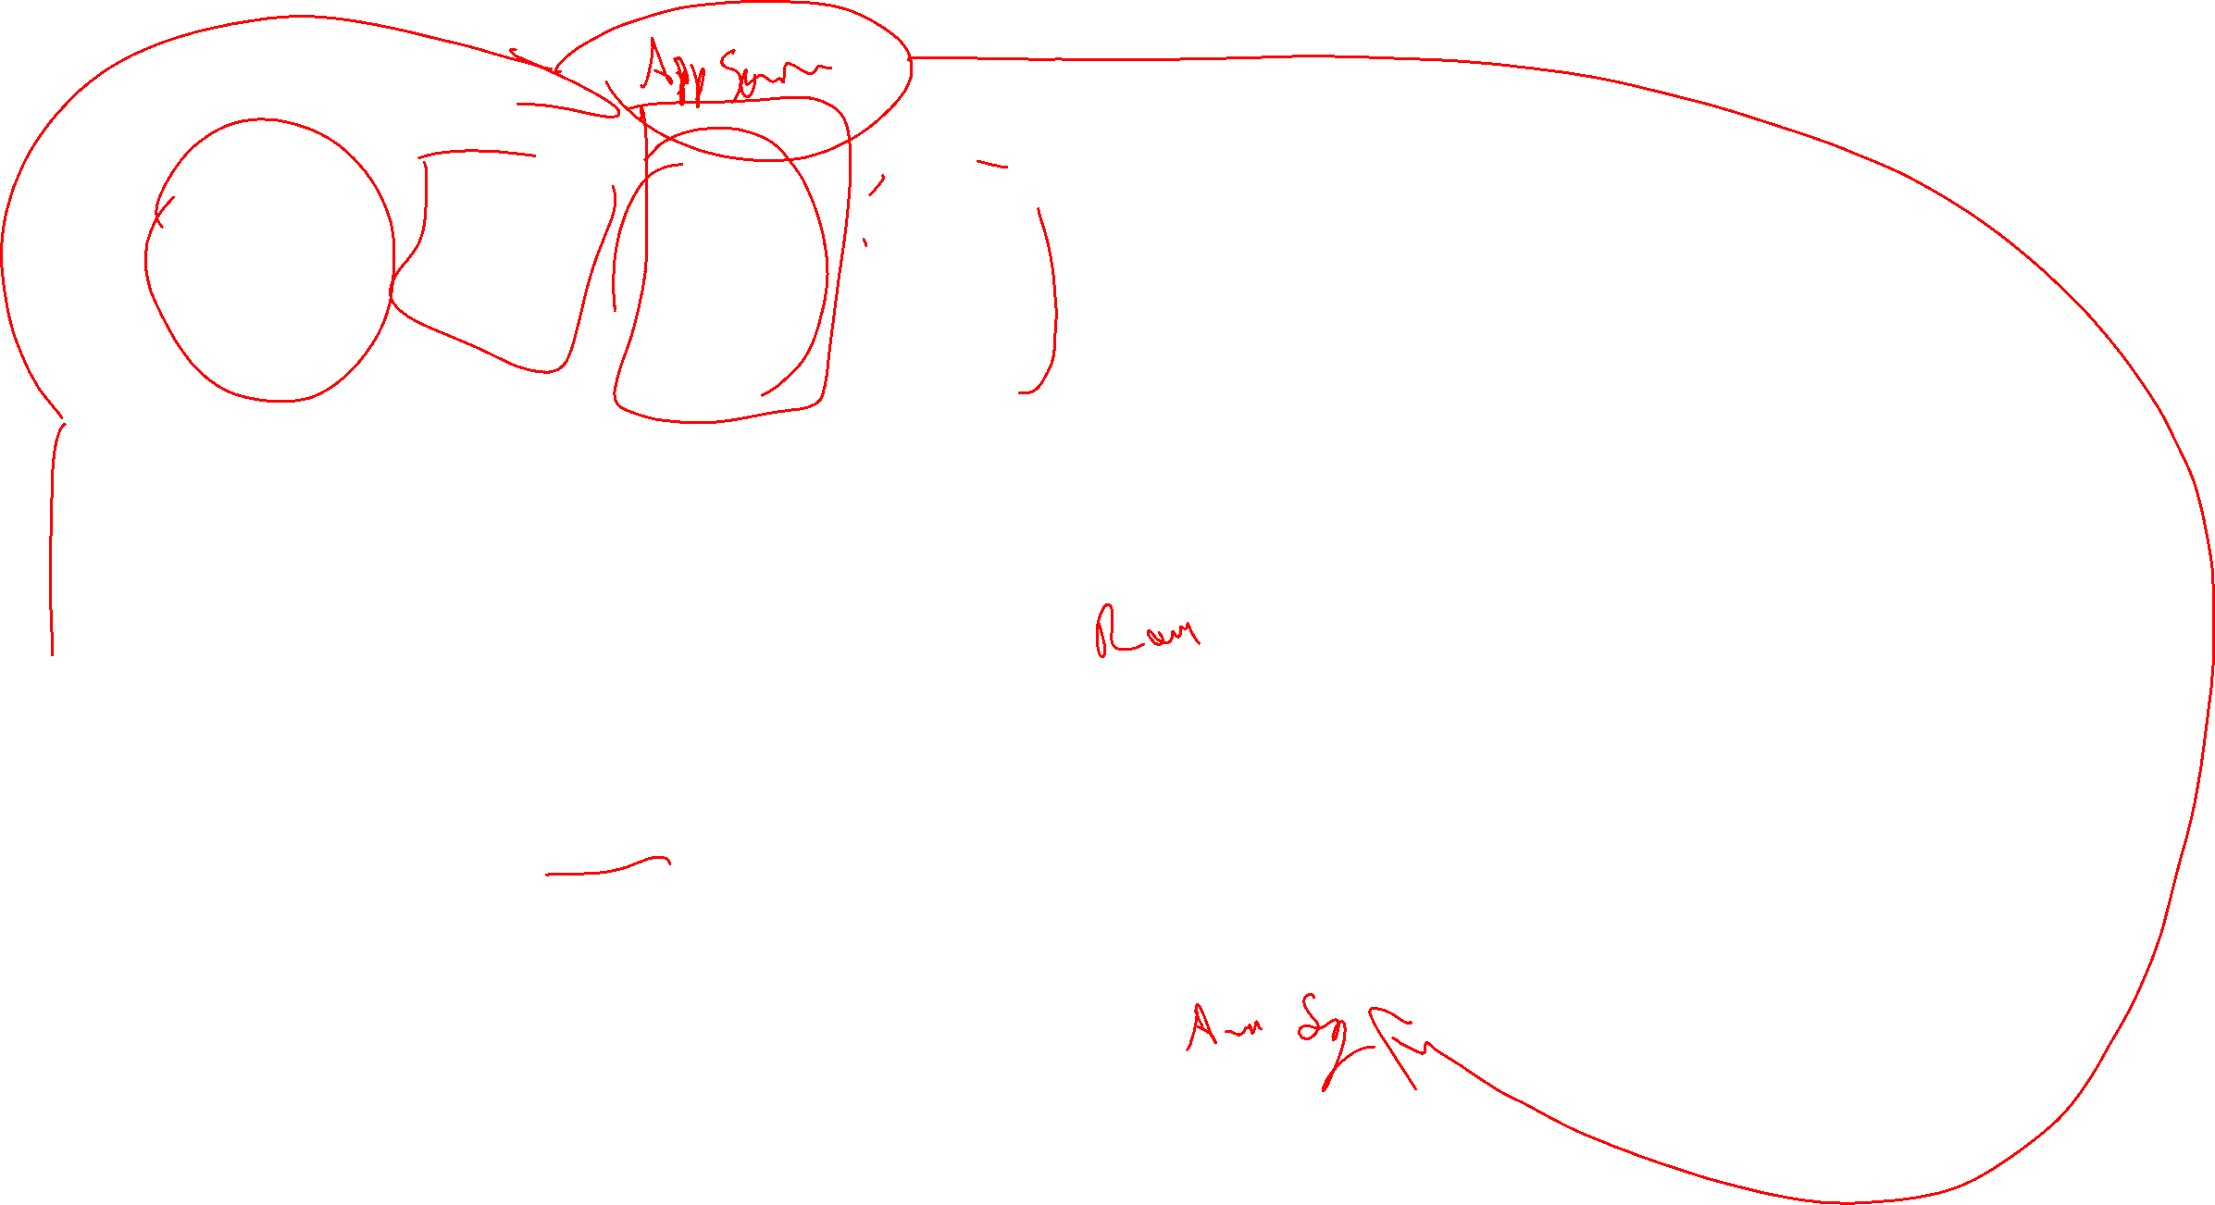
User
Group
Service Principal
Managed Identity
Assign a security principal
Security Principal
Azure RBAC
Azure role-based access control
Development Group
Assign a role
Contributor
Operation type (R/W/C/D)
Dev and Playground Resource Group
Role
Role assignment
Management Group
Subscription
Resource Group
Resource
Assign a scope
Scope

Slide 26


Secrets scanning
Protecting your code, your secrets, your identity
SCAN COMMITS BEFORE A PUSH
(1) Place git-secrets somewhere in the PATH to be easily accessible by git
(2) ./install.ps1 | Command to install git-secrets on a Windows machine
(3) cd /path/RaduVRepo/IoTHome | Navigate to the repo that you want to protect. You need to do this action for each repository that you want to secure
(4) git secrets install | Install the tool
(5) git secrets -register-azure | Register the Azure plugin
(6) git secrets -register-aws | Register the AWS plugin
(7) git secrets - register-gcp | Register the GCP plugin

Slide 27
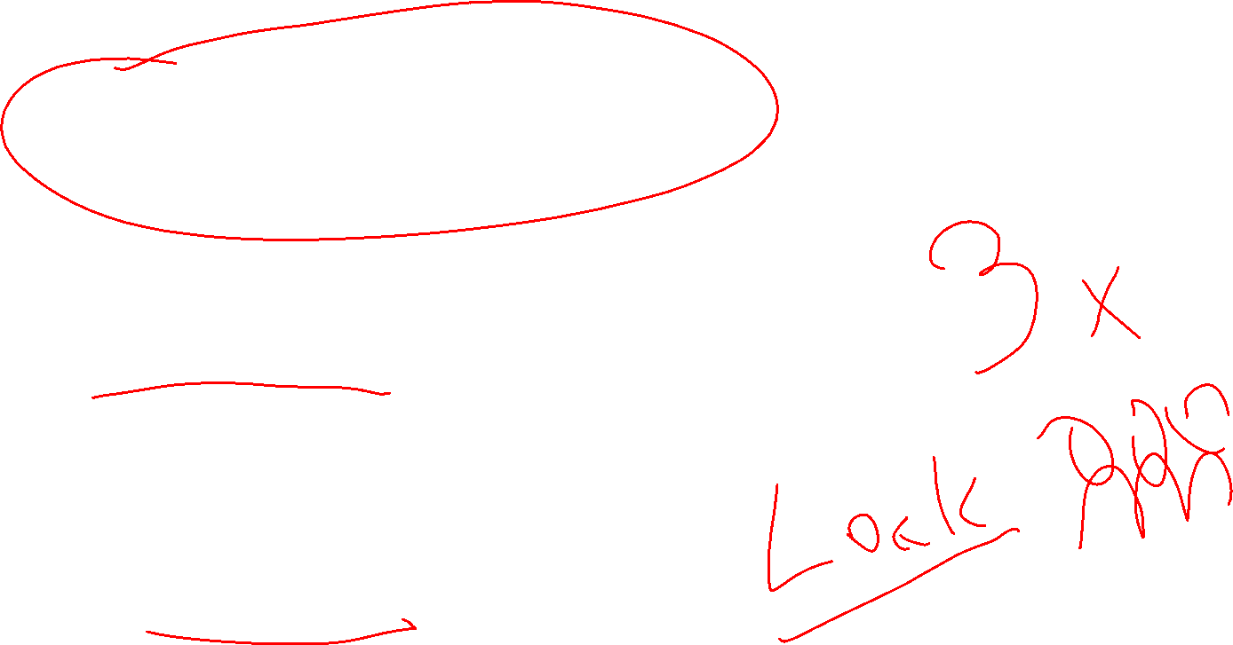
Secrets scanning
Protecting your code, your secrets, your identity
SCAN COMMITS BEFORE A PUSH
> Reject commits when secrets are detected
PIPELINE INTEGRATION
> Build fail
> Remove secrets
NIGHTLY SCAN
> Remove secrets
> Repository and Pipelines freeze

Slide 28
Azure RBAC
Azure role-based access control
Duty segregation within your team
Grant only the amount of access to users that they need to perform their jobs

Slide 29
Azure RBAC
Azure role-based access control
Duty segregation within your team
Grant only the amount of access to users that they need to perform their jobs
RBAC
!
Specific permissions create unneeded complexity and confusion, accumulating into a “legacy” configuration that’s difficult to fix without fear of breaking something.

Slide 30

Azure RBAC
Azure role-based access control
Duty segregation within your team
Grant only the amount of access to users that they need to perform their jobs
RBAC
Specific permissions create unneeded complexity and confusion, accumulating into a “legacy” configuration that’s difficult to fix without fear of breaking something.
Avoid resource-specific permissions. Instead, use management groups for enterprise-wide permissions and resource groups for permissions within subscriptions.
Avoid user-specific permissions. Instead, assign access to groups in Azure AD

Slide 31
WHAT CAN WE DO?
Ensure that default security features of cloud services are active.
Ensure that security best practices are followed and implemented.

Slide 32

WHAT CAN WE DO?
MORE:
Tracing and monitoring
LESS:
Rely only on app logs

Slide 33

Deep Application Monitoring
Deep Infrastructure Monitoring
Application Insights
Security Center & Defender
Log Analytics
Network Monitoring
Service Map
Application
Core Monitoring
OS
Azure Monitor
Advisor & Service Health
Activity Log
Metrics
Logs
Resource
Audit
Shared Capabilities
Subscription
Alerts
Dashboards
Metric Explorer
Tenant

Slide 34



PROCESSED EVENTS
DATA PLANE LOGS
CONTROL & MANAGEMENT
LOGS
PROVIDE INFORMATION ABOUT ANALYZED EVENTS / ALERTS THAT HAVE BEEN PROCESSED ON YOUR BEHALF
PROVIDE INFORMATION ABOUT EVENTS RAISED AS PART OF AZURE RESOURCE USAGE
PROVIDE INFORMATION ABOUT AZURE RESOURCE MANAGER CREATE, UPDATE, AND DELETE OPERATIONS
AZURE MONITORING LOGS
AZURE MONITORING METRICS
Azure Security Center alerts where Azure Security Center has processed and analyzed your subscription and provides concise security alerts
Windows Event System, security, and app logs in a VM and the diagnostics logs that are configured through Azure Monitor
Change in a resource configuration, change of the resource tier size

Slide 35
WHAT CAN WE DO?
MORE:
Secure public endpoints.
Protect your endpoints using a Firewall.
LESS:
Don’t forget about OWASP protection

Slide 36




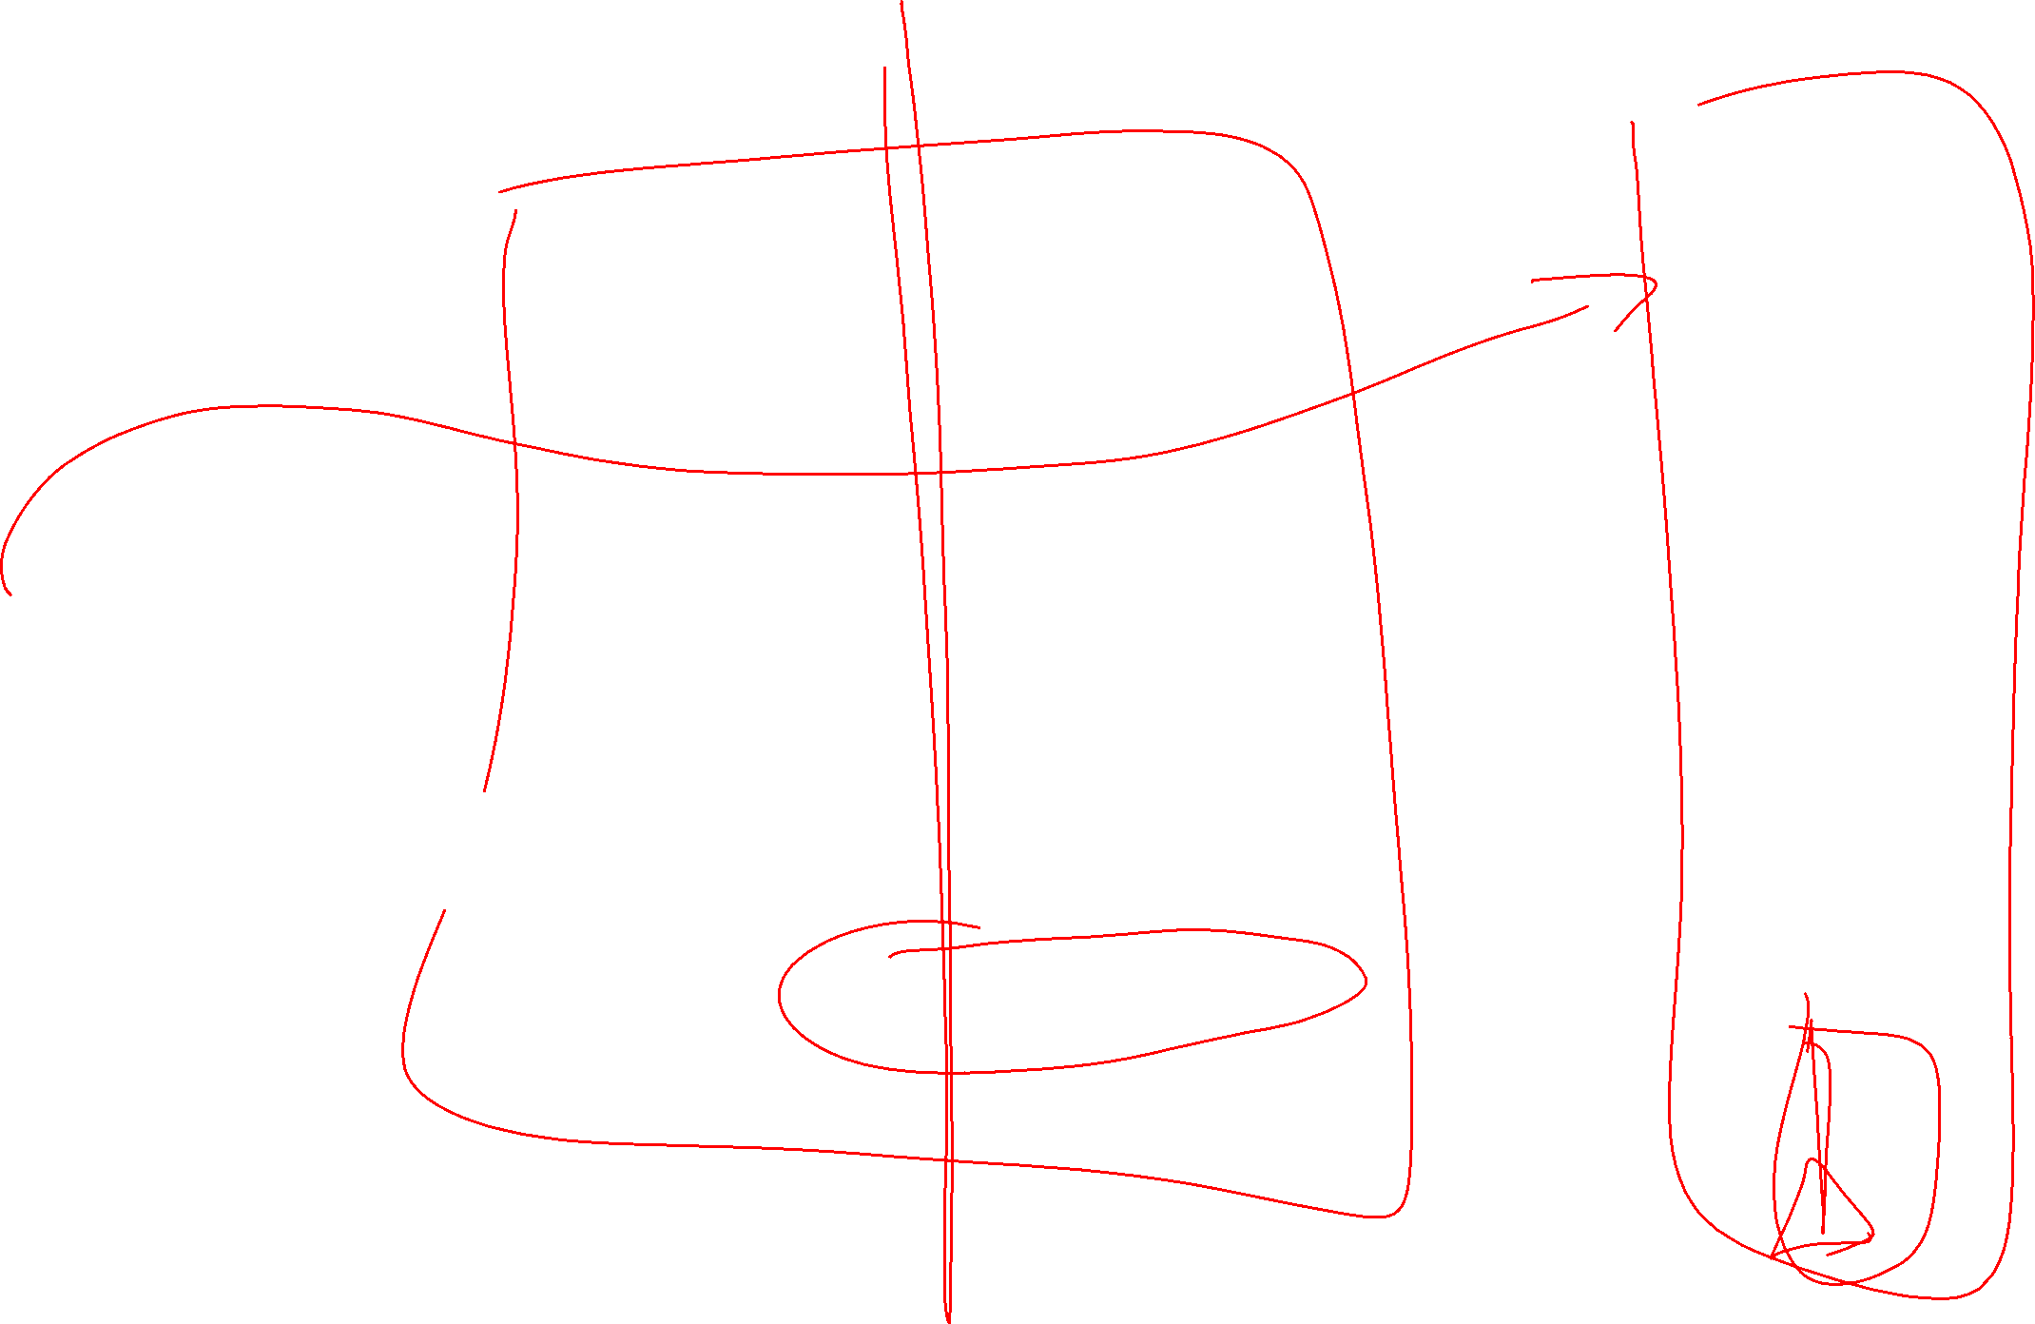
AWS WAF
AZURE APPLICATION GATEWAY
L7 LOAD
BALANCER
XSS
SQL INJECTION
WEB APP FIREWALL
OWASP (CRS RULES)

Slide 37

WHAT CAN WE DO?
MORE:
Integrate the build-in security systems
LESS:
Rely less on custom dashboards

Slide 38





Secure Score
Overall secure score
Security controls
Compliance
Azure CIS
PCI DSS 3.2
ISO 2007
SOC TSP
Custom definition
Azure Defender
Security Alerts
Advance Thread Protection
Vulnerability assessment and mng
On-premises and Azure protection
Inventory
Explore, filter and enhanced your resources
Microsoft Defender for Cloud
Discover and assess the security of your workloads

Slide 39
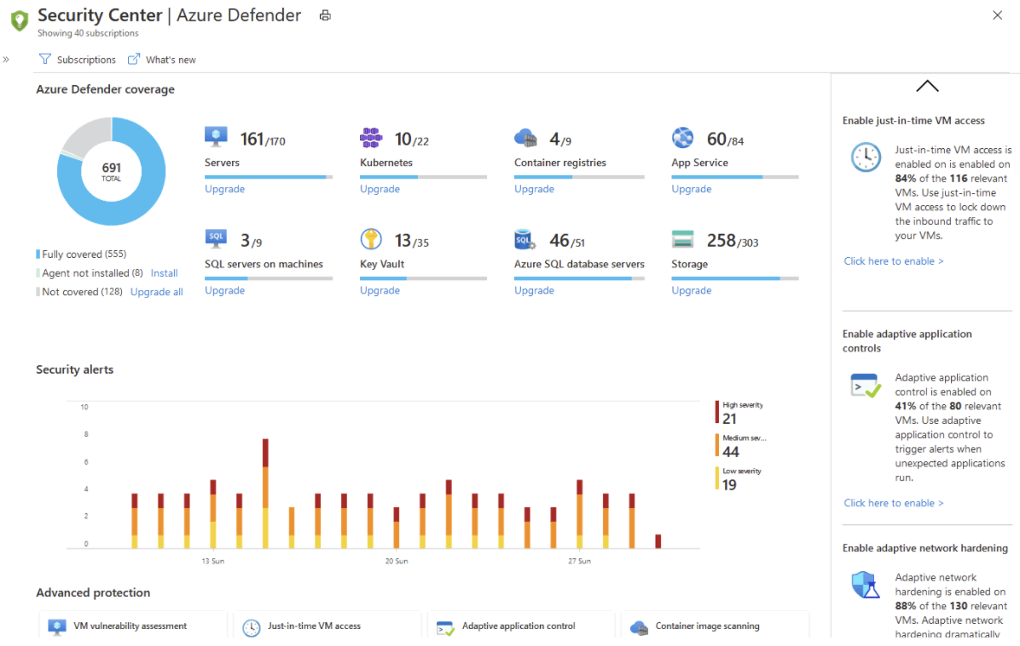

Defender
Cloud workload protection

Slide 40
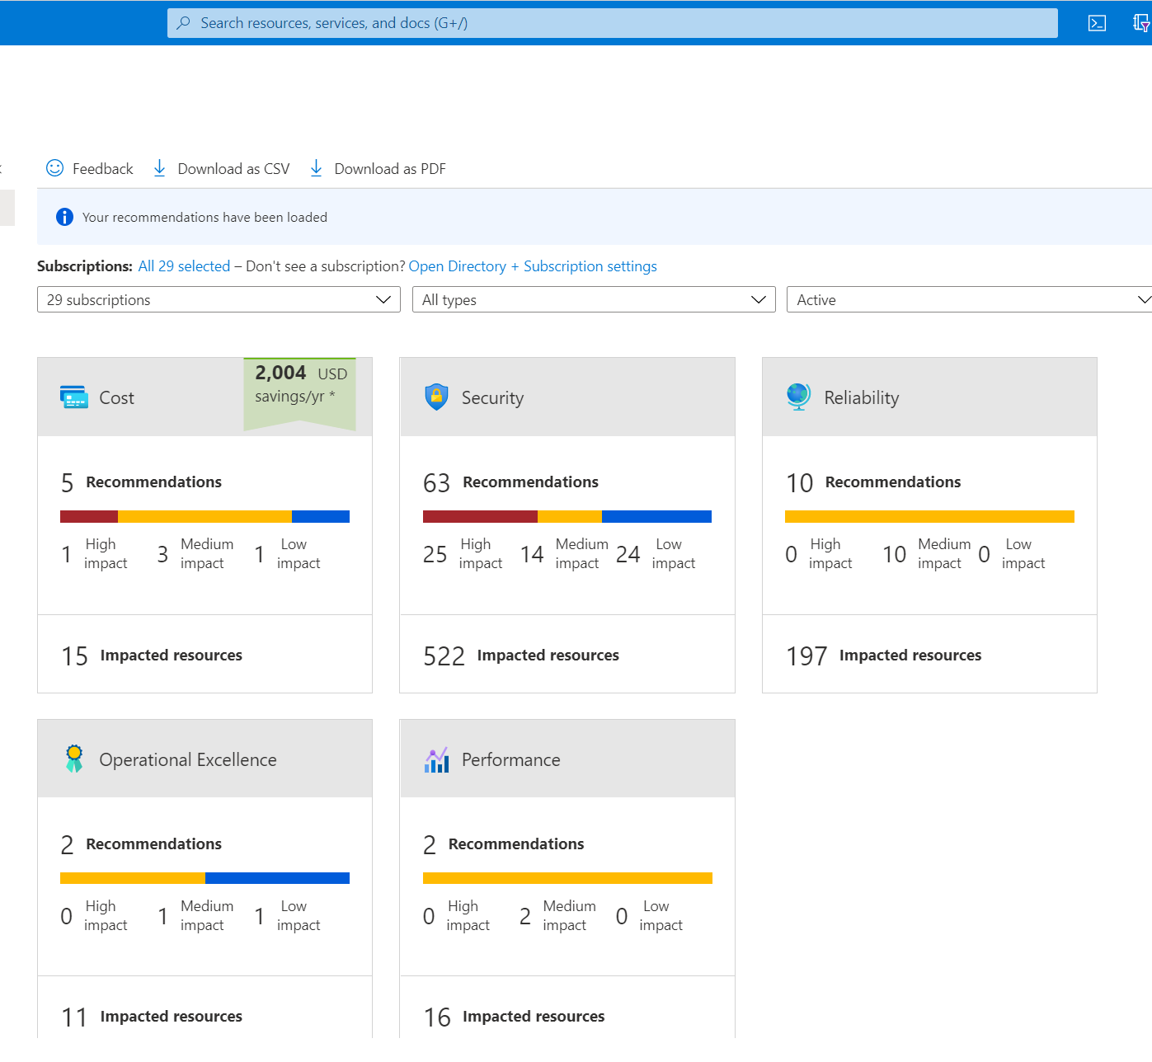

Azure Advisor
Proactive, actionable, and personalized best practices recommendations
Reliability
Security
Performance
Cost
Operational Excellence

Slide 41

FINAL THOUGHTS

Slide 42
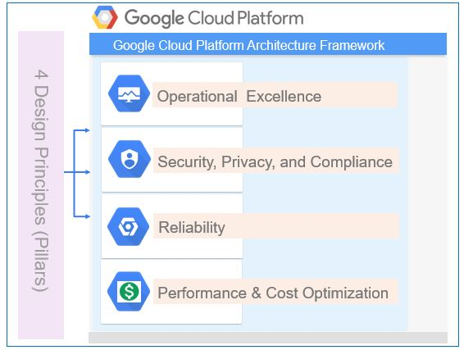
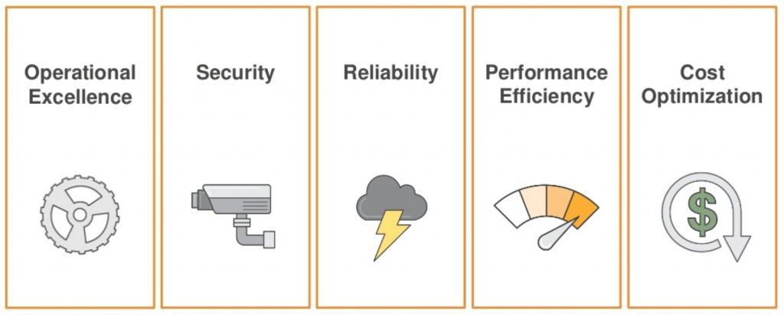
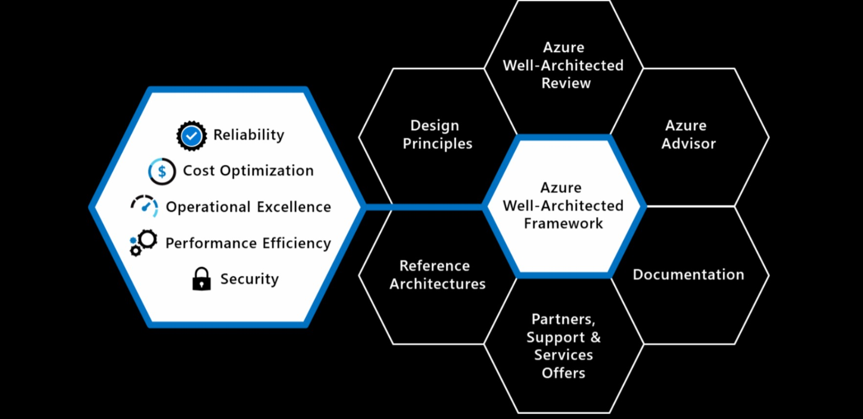

Notes:
<Key point>: Cloud Adoption Framework—modular phases of adoption.
As your organization evolves, the Cloud Adoption Framework adapts to your business needs.
Each module in the diagram is an iterative phase that advances your business through the complete lifecycle of cloud adoption.
Customers can choose the phase best-suited to their degree of cloud adoption maturity. The Cloud Adoption Framework offers a guiding methodology to cloud adoption, with specific approaches to overcoming common blockers to cloud adoption in each module, such as “Define Strategy,” “Plan,”, etc.
The Cloud Adoption Framework offers the enterprise a modular framework of how to incrementally onboard to the cloud.
Cloud adoption shifts how companies obtain, make use of, and lock down their technology resources.
And—this kind of modular framework flips the model of how enterprises operate:
Transitions organizations to need-based consumption of technology resources
Change from cap-ex (capital expenditure) to op-ex (operating expenditure) model
Cloud model assumes security, governance, cost-optimization, and hybrid cloud by default
Develop a future-ready workforce—developing and deploying cloud skill readiness organization-wide
As an organization progress through the Cloud Adoption Framework, what are the main goals of each methodology of “Define Strategy,” “Plan,” you can focus efforts on?
<Transition>: Now that we have taken look at the phases and modular approach, lets look at about some common business blockers that the Cloud Adoption Framework can help you resolve.

Slide 43
THANK YOU
@RaduVunvulea

